Slide 1
Midterm Presentation
Tyson, Diana, Erica, Eli, Alisa

Slide 2
Project Overview
Diana
CMS Medicare Physician & Other Practitioners - 2024
9,781,673 records and 28 original columns
No exact duplicate rows identified
Reviewed column meanings, data types, unique values, and missingness

Slide 3
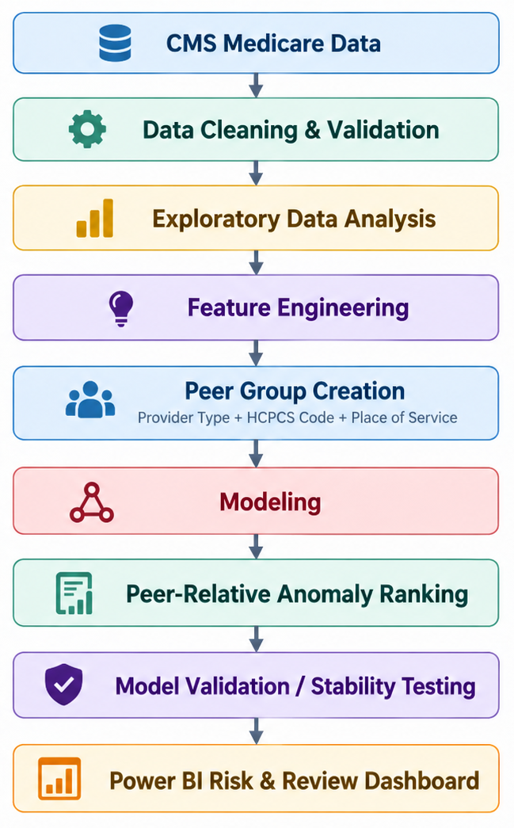
System/Workflow
Diana

Slide 4
Data Cleaning
Alisa
Removed logically invalid rows:
  non-US providers
  Tot_Srvcs < Tot_Benes
  Tot_Bene_Day_Srvcs > Tot_Srvcs
  allowed amount ≤ 0
9,781,161 rows left (512 removed)
row_id added after cleaning so all models can be joined

Slide 5
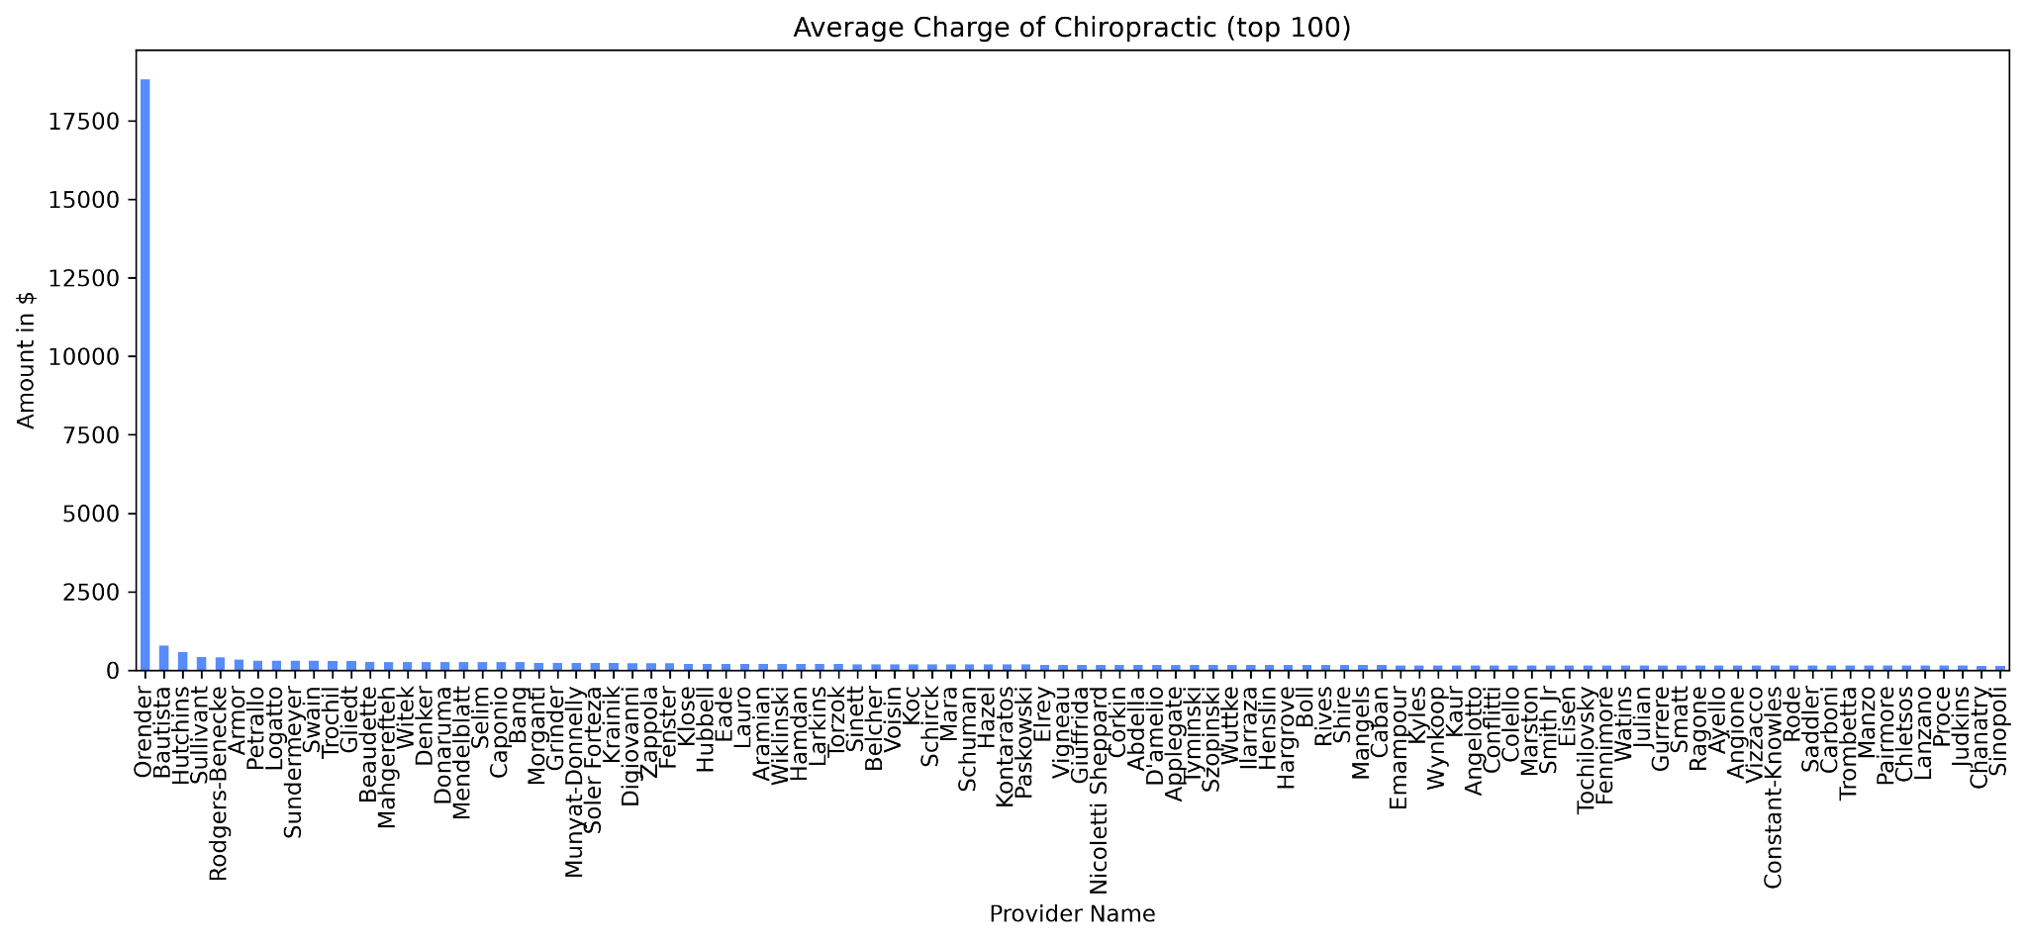
Analysis that drove decisions
Tyson
Are outliers really present? Yes
What kind of outliers are there?
  Amount of Unique providers
  Average Charge
What do the outliers look like?

Slide 6
Analysis that drove decisions
Diana
Peer Group Methodology
Primary Peer Group:
Provider Type + HCPCS Code + Place of Service
Provider Type controls for differences between specialities
HCPCS Code ensures providers are performing the same service
Place of Service controls for facility vs. non-facility billing environments

Slide 7
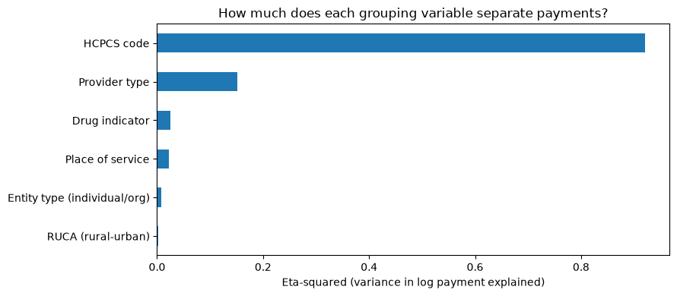
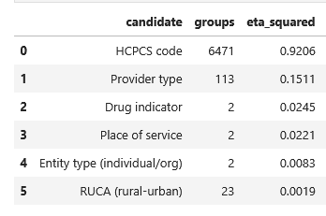
eta-squared:
HCPCS code explains most payment variation
Eli
HCPCS explains the most (0.92), but its 6,471 groups inflate the score, so it does not make providers comparable
Provider Type controls for specialty differences
Place of Service controls for facility vs non-facility billing
All three stay in the peer group; entity type and RUCA add little

Slide 8
Analysis that drove decisions
Diana
Peer Group Methodology
Tested peer-group sizes of 30, 50, 100, and 200 records.
Compared anomaly rankings against the full-peer reference model.
Larger peer groups improved ranking agreement and reduced variability across repeated samples.
Random seed tests showed minor improvements in ranking stability as group size increased.
Notes:
To evaluate the effect of peer group size on Machine Learning models, models were trained using samples of 30, 50, 100, and 200 records drawn from same larger peer populations. Each model’s anomaly ranking was compared with the ranking produced by the full-peer reference model. As training size size increased, agreement with the reference model improved and variability across repeated samples decreased, showing that peer-group size has a measurable effect on the consistency and representativeness of the anomaly rankings.
In addition, different random seeds were tested to check whether model rankings remained stable across repeated runs. As training size increased, agreement with the reference model has improved and variability decreased, while the random seed tests showed minor improvements with the growth of the group size

Slide 9
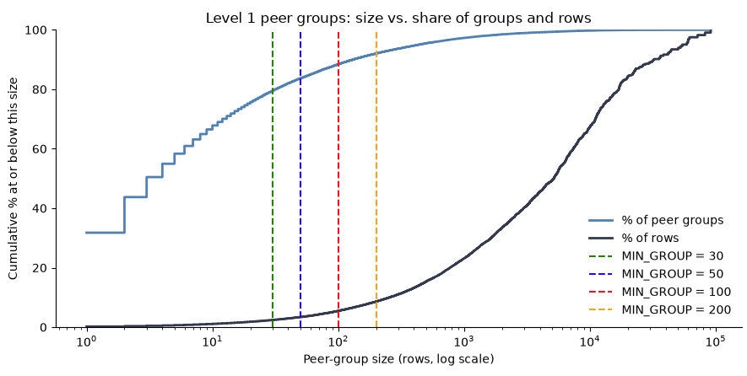
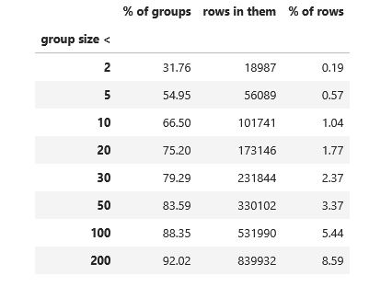
Where the Data Sits
Eli
Groups under 100 rows are 88.35% of Level 1 groups but hold only 5.44% of rows.

Slide 10
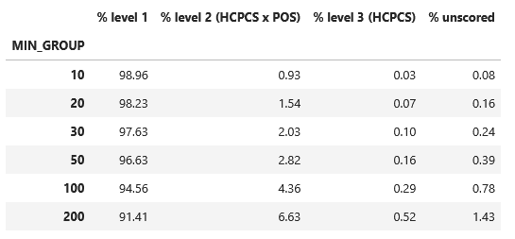
Where the data is allocated based on group size
Eli

Slide 11
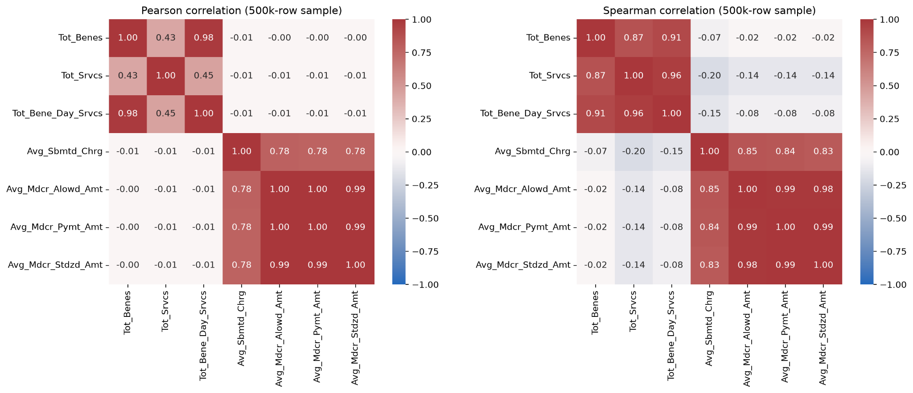
Feature Selection - Raw correlation | Erica
Notes:
# raw pearson correlation: driven by extreme rows, but spearman, while handling skew well, will pool the rows and ignore peer groups. the latter also uses ranks when IsoForest and DBSCAN use log-scared values, so spearman will not show whether a log transformation helped. but, a log matching pearson matching spearman would be good evidence that a transformation is appropriate...... *
# raw columns and not final features mean we don't know for sure if the final features are redundant
# at a first glance, tot_srvcs - tot_benes in pearson is .43 when it's .87 in spearman

Slide 12
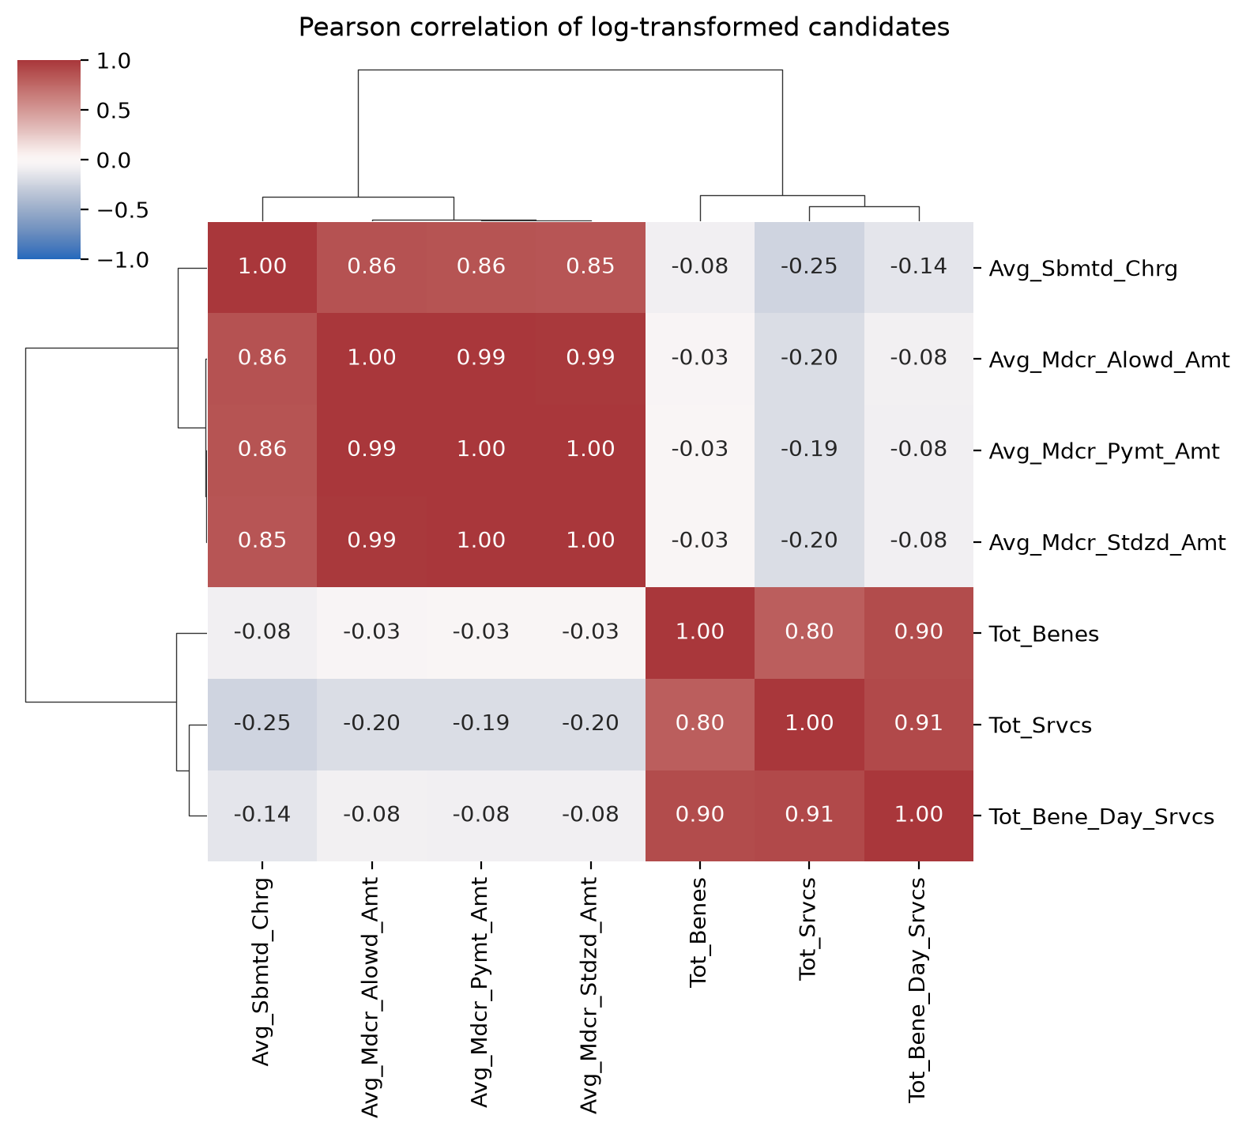
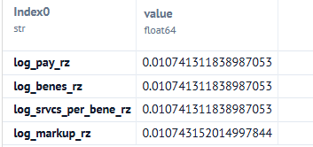
Log Transformed
correlation and Mean Abs Dev
Notes:
There are two clear blocks, with less than seven "actually independent" signals...
# this transformation aligns better with tot_srvcs - tot_benes being 0.8. Log transform pearson in agreeance with spearman means we are now describing typical rows and not outliers.
# MAD ~ 1.07% missing for every feature, where l_p_r and l_s_p_b_r used to be ~%12 and ~%29 missing a z-score (where the typical spread is exactly 0 because the providers have identical value)

Slide 13
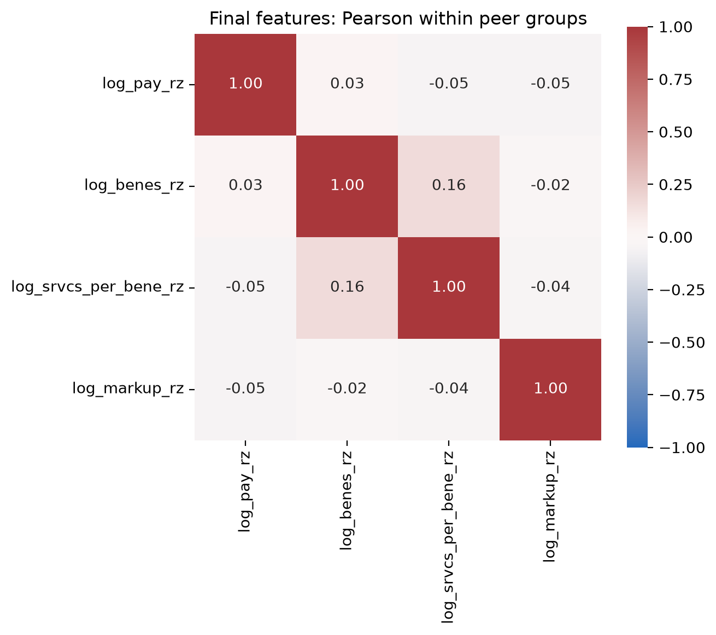
Recommended features from testing
Erica
Notes:
There are two clear blocks, with less than seven "actually independendent" signals...
# this transformation aligns better with tot_srvcs - tot_benes being 0.8. Log transform pearson in agreeance with spearman means we are now describing typical rows and not outliers.

Slide 14
Feature engineering
Alisa
Feature | Meaning
log_pay_rz | Medicare payment for the service "Avg_Mdcr_Stdzd_Amt"
log_benes_rz | Volume (number of patients) "Tot_Benes"
srvcs_per_bene_rz | Services per patient "Tot_Srvcs"/ "Tot_Benes"
markup_rz | How much the provider bills compared to what Medicare considers the right price amount. "Avg_Sbmtd_Chrg" / "Avg_Mdcr_Alowd_Amt"
Volume and payment columns are highly correlated (k = 0.87-0.99), so one feature per group + ratios
Log transform because all features are heavily right-skewed

Slide 15
Robust Z-Scores + Fallback
Alisa
rz = (x − median) / (1.4826 × MAD), computed inside each peer group
Median and MAD instead of mean and SD, so extreme values don’t hide outliers
Min group size 100, fallback:
  Level 1: Type × HCPCS × POS
  Level 2: HCPCS × POS
  Level 3: HCPCS

Slide 16
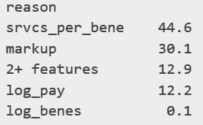
Baseline Model
Alisa
Flags unusually high billing vs peer group
Flag if 1 feature > 10 or 2+ features > 3.5 robust SD
1.16% of rows flagged (114,765)
Risk tiers among flagged rows:
  High 15% / Medium 35% / Low 50%
What drives the flags(% of the flags):

Slide 17
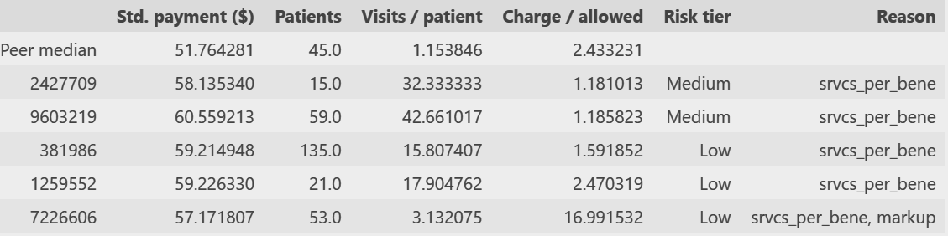
Baseline Output: Example
Alisa
Nurse Practitioner x 99213 (office visit) x Office
Total of: 82,322 rows
Four of the top five flags bill 16–43 visits per patient vs a peer median of 1.15. The fifth is flagged on two features: more visits (3.1) and a 17x markup vs 2.4.

Slide 18
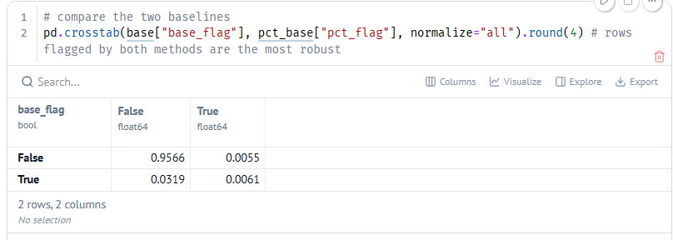
Baseline and percentile exploration supporting team findings
Erica

Slide 19
Modeling DBSCAN
Tyson
How DBSCAN works:
Takes in groups (in this case peer groups)
Takes in a list of numerical features
Uses Vectors and Matrices to calculate Euclidean distance between each record and the next closest record.
Outputs a distance feature to each record allowing for easy sorting and analysis.

Slide 20
Modeling DBSCAN
Tyson
Used DBSCAN for unsupervised clustering:
Grouped data by HCPCS code, Place of Service, Provider Type, and Provider Entity.
Clustered data by Total Beneficiaries, Total Services, Distinct Services per Beneficiaries, Average Submitted Charge, Average Allowed Amount, and Average Standardized Amount.
DBSCAN has contributed to the conclusion that about 90% of the data has a euclidean distance of 0.5 or less.

Slide 21
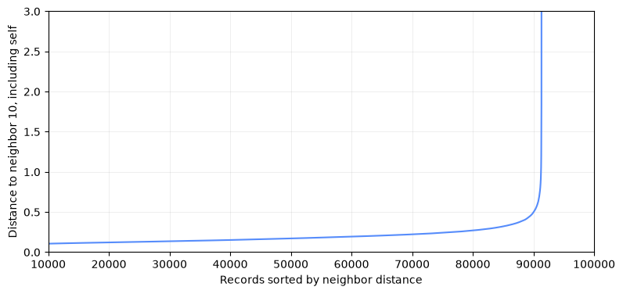
Demo DBSCAN

Slide 22
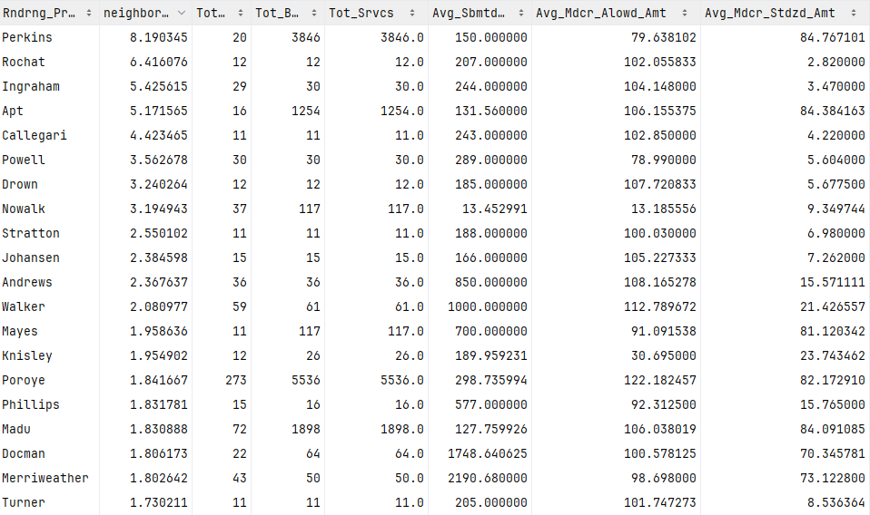
Demo DBSCAN

Slide 23
Modeling Isolation Forest
Diana
Unsupervised anomaly-detection algorithm
Appropriate because the dataset does not contain confirmed fraud labels
Trained separately within peer groups
High anomaly scores indicate behavior that is more unusual relative to that provider’s peer group
Comparison between high risk provider and median of the group
Type | Services/Benef. | Charge Ratio | # Benef.
Anomaly(Score 100) | 1.10256 | 1.67586 | 39.0
Peer Median | 11.26849 | 2.09802 | 97.0

Slide 24
DEMO
Isolation Forest
Diana
This table shows the top anomaly records within a peer group, including provider volume, service intensity, billing ration, and Medicare payment information. The IF Raw Score is the direct Isolation Forest Anomaly Score, where higher values indicate more unusual behavior, while Anomaly score converts that ranking into a peer relative 0-100 percentile
NPI | Beneficiaries | Services | Services / Beneficiary | Services / Bene-Day | Charge / Allowed | Payment / Allowed | Std. Medicare Payment | IF Raw Score | Anomaly Score
Rank
1 | 1063709962 | 39 | 43.0 | 1.10 | 1.02 | 11.27 | 0.41 | 50.93 | 0.733 | 100.00
2 | 1699168328 | 76 | 152.0 | 2.00 | 1.04 | 11.72 | 0.63 | 78.47 | 0.713 | 100.00
3 | 1477713139 | 20 | 36.0 | 1.80 | 1.03 | 11.75 | 0.64 | 80.57 | 0.710 | 100.00
4 | 1376040709 | 63 | 107.0 | 1.70 | 1.02 | 11.71 | 0.57 | 71.43 | 0.702 | 99.99
Comparison between high risk provider and median of the group

Slide 25
Modeling Isolation Forest
Diana
IF Raw Score: Based on average path lengths across random isolation trees. Records isolated with fewer splits are more anomalous. Scores are inverted ( x (-1)) so higher values indicate stronger anomalies.
Anomaly Score (0–100): Raw scores are ranked within each peer group using rank(pct=True) × 100. Higher percentiles indicate more anomalous records relative to their peers.
Notes:
IF Raw Score is calculated directly by Isolation Forest from the average path length across many random isolation trees. Records that require fewer splits to isolate are considered more unusual. In my code I have inverted the scores by multiplying them by -1, so larger values represent stronger anomalies. Originally, lower means higher anomaly.
Anomaly score takes the raw scores that are ranked within the same peer group using built in pandas function rank(pct=True) * 100. This converts the raw model output into a peer relative percentile from 0-100, where a score near 100 means the record ranks among the most anomalous in that peer group.

Slide 26
Progress to Date
Diana
Completed dataset review and variable interpretation
Completed initial exploratory data analysis
Identified major differences across provider types, HCPCS codes, and places of service
Defined most of peer group methodology
Build initial robust z-scores, Isolation Forest, and DBSCAN models
Produced peer relative anomaly scores
Tested different minimum peer group sizes

Slide 27
Challenges and Next Steps
Diana
Challenges:
Continue discussion on peer groups size
Designing fallback logic for peer groups that remain too small
Validate an unsupervised model without confirmed fraud labels
Next Steps:
Run and train our finalized models
Compare results with each other and robust peer-relative baseline
Perform additional stability and sensitivity testing
Build Power BI review dashboard
Add drill through explanations showing why individual records received high anomaly scores
Find standard columns for the df

